Slide 1


Introduction to the Theology
of the Created for Greatness
Program
Diocese of St. Augustine | 11625 Old St. Augustine Road | Jacksonville, Florida 32258

Slide 2
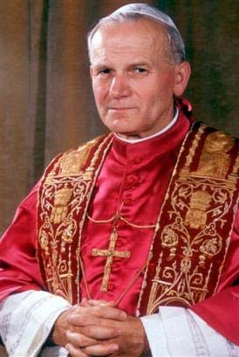
Saint John Paul II
and the Created for Greatness
Program
The Created for Greatness Program is based entirely on Saint John Paul II’s 129 Wednesday audiences during his early papacy (1979-1984), which are now commonly referred to as the Theology of the Body.
  St. John Paul II’s Theology of the Body is a persuasive anthropological biblical reflection on God’s mystery discovered in the human person.

Slide 3
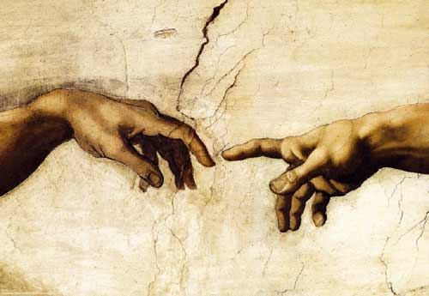
The Book of Genesis:
God Creates Humans
for Greatness
St. John Paul II begins his preaching on the creation of man and woman in the book of Genesis, in which God forms man and woman in His image and pronounces them “good” and “beautiful.”
  The human body reveals the human person.
  God gratuitously creates the human person and shows us our dignity and value.
  By our very nature, we are created for relationship.
Genesis 1-3

Slide 4
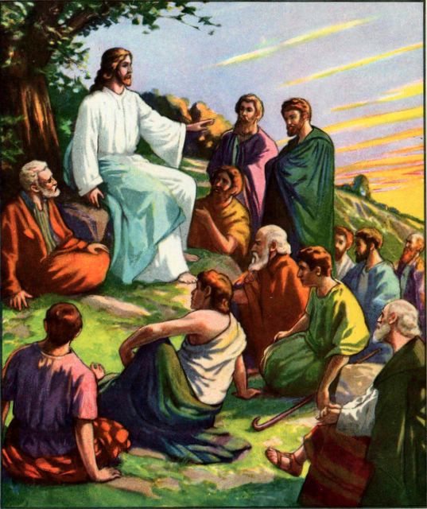
The Sermon on the Mount:
Jesus Calls Us To Greatness
The Pope continues his catechesis by turning to Christ and exploring His Sermon on the Mount as the heart and core of Christian morality.
  God establishes his loving covenant with all people in which we are called to holiness.
  Human beings are called to be pure of heart.
  Christ elevates the value of the human body through His own humanity.
Matthew 5-6

Slide 5
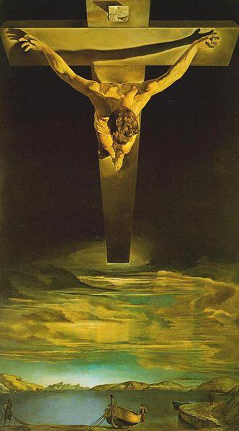
The Paschal Mystery of Christ:
We Are Redeemed for Greatness
Through Christ’s Incarnation, life, passion, death, resurrection, and eventual return in glory, humanity experiences the redemption of the body.
  The resurrected body of Jesus is still a human body.
  In the Resurrection, the human body will be “spiritualized” and “divinized.”
  God calls us to participation in the gift of the life giving Spirit in the fruit of Christ’s death and Resurrection.
Romans 8:14-17, 26-27

Slide 6

Our Vocation:
God’s Plan for Our Greatness
Because we are called for holiness, God calls us to the vocation that we are reserved for and dedicated to God.
  There are four vocations that all people are called to live out God’s call to holiness in love.
  All of these vocations are complementary to one another.
    Marriage
    Consecrated Life
    Ordained Priesthood
    Single Life
1 Corinthians 12:4-31

Slide 7
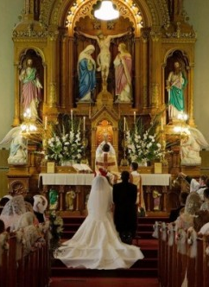
The Sacrament of Marriage:
A Reflection of God’s Greatness
“The matrimonial covenant, by which a man and a woman establish between themselves a partnership of the whole of life and which is ordered by its nature to the good of the spouses and the procreation and education of offspring, has been raised by Christ the Lord to the dignity of a sacrament between the baptized” (Canon 1055).
  Marriage is a reflection of Christ’s love for His Church.
Ephesians 5:21-33

Slide 8

Song of Songs:
Love Forms Us for Greatness
“The Song of Songs is certainly found in the wake of that sacrament in which, through the language of the body, the visible sign of man and woman’s participation in the coverage of grace and love offered by God to man is constituted” (TOB, 5/23/84).
  Love unleashes a special experience of the beautiful, which involves the entire person.
Song of Songs 5:6-8

Slide 9
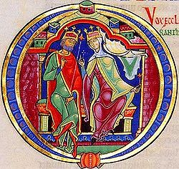
Humanae Vitae:
Truth and Freedom Leads to Greatness
Humanae Vitae states that the fundamental element of the spirituality of married life is the love poured out into the hearts of the couple as a gift of the Holy Spirit.
  Truth and the freedom to love are essential to the dignity of the human person.
  Human love is connected with the respect for life.
  Humanae Vitae is related to both the sacrament of marriage and the whole biblical question of the theology of the body

Slide 10
Created for Greatness:
Introductory Resources for Adults
Man and Woman He Created Them: A Theology of the Body, Pope John Paul II, Dr. Michael Waldstein (translator), Pauline Books & Media: 2006
Theology of the Body for Beginners, Christopher West, Ascension Press: 2009
Theology of the Body in Context: Genesis and Growth, William E. May, Pauline Books & Media: 2010.
Theology of the Body Made Simple, Anthony Percy, Pauline Books & Media: 2005.

